Slide 1

NATIONAL
TECHNOLOGY
DAY
11 may

Slide 2
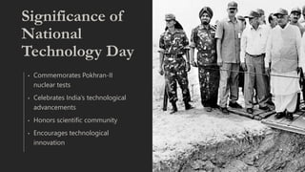
SIGNIFICANCE OF NATIONAL TECHNOLOGY DAY
Commemorates Pokhran –ii nuclear tests
Celebrates India’s technological advancements
Honors scientific community
Encourages technological innovation

Slide 3

Pokhran-ii nuclear tests
Conducted in MAY 1998
Marked India as a nuclear state
Demonstrated technological prowess
Led by A.P.J Abdul kalam

Slide 4

IMPACT ON INDIA’S GLOBAL STANDING
Established India’s strategic autonomy
Enhanced national security
Devated India’s global position
Demonstrated commitment to peaceful usage

Slide 5

TECHNOLOGICAL ACHIEVEMENTS
Progress in space technology
Advancements in IT sector
Growth in biotechnology
Innovations in defense technology

Slide 6

ROLE OF SCIENTISTS AND ENGINEERS
Indian scientists have made significant contribution to technological advancements in India.
Engineers play a crucial role in implementing these scientific discovers into practical applications.

Slide 7
Made by Garima sharma

